Slide 1
MEMS Final Presentation
Charles Zhang

Slide 2
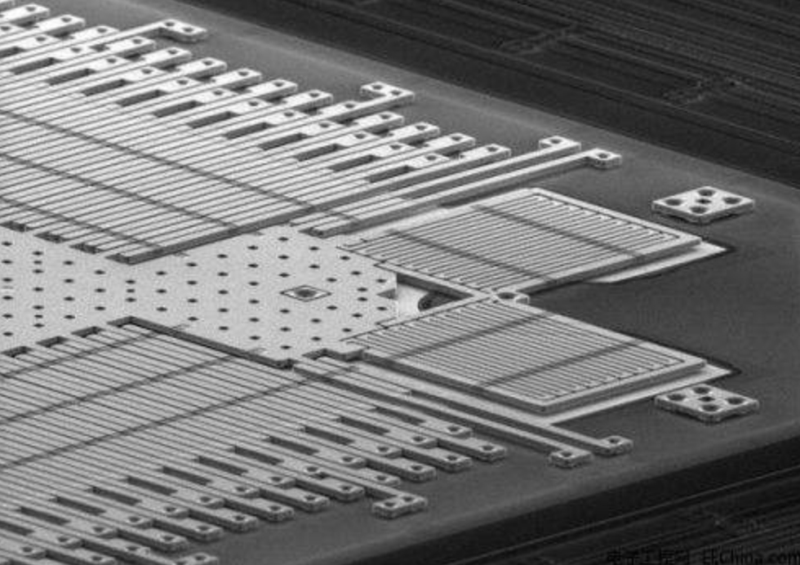
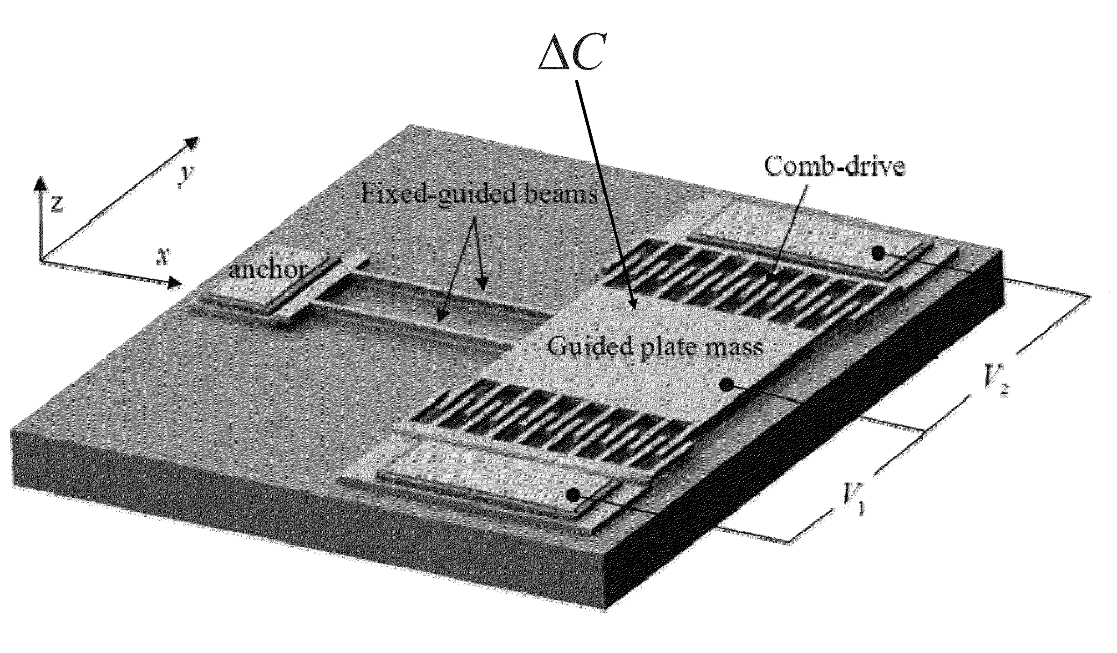
Background MEMS and Comb Drive
Micro-Electro-Mechanical Systems
Beams + Parallel Plate Capacitor
Notes:
In contemporary society, the MEMS devices has done a significant role in many field, like accelerator, motor and tweezers. Because of its advantage like the scaling of MEMS devices reduces the cost per device although the total cost to fabricate one wafer. This is because the number of devices on each wafer increase dramatically with the decrease of the feature size of MEMS devices. In addition, the finer fabrication process provides high performance of MEMS devices, e.g. the accuracy and precision of MEMS sensors are orders of magnitude higher than conventional sensors. ² Therefore, MEMS has become a focus of both fundamental research and applicable engineering.
Among all the MEMS applications, the comb drive uses electrostatic force as the actuation principle. There are two metal conductor of micron scale, shape of the comb. They both alternate with each other where one is contact and another not. When plus an alternating current, one of the comb will be relative to another conductor moving. More specifically, more and more scientists prefer to use the comb drives for electrostatic actuation, capacitive position sensing and frequency turning.¹ [3]They have become an inalienable part of many MEMS devices such as accelerometers, gyroscopes, and micro scanners and so forth.⁴

Slide 3
Method Stimulation
Numerical method Visualization Optimization
Notes:
Simulation: 用数值计算来仿真，模拟
Numerical method: The numerical calculation is approximate.
Therefore we use the numerical calculation more nowadays because of the more and more complex compute.
Parts:
Discretize-----Mesh (reveal the change (connection)) 3D: tetrahedral
Approximate----------calculate displacement; Physics and boundary conditions (tell the COMSOL calculate what)
3. Assemble-----------Combine all the displacements
Fabrication:
Optimization:
Constraints (condition to constrain)
Objective (in order to get optimal model)
Optimization method （Monte Carlo and Gradient descent）
Pic 1 change the potential----result

Slide 4
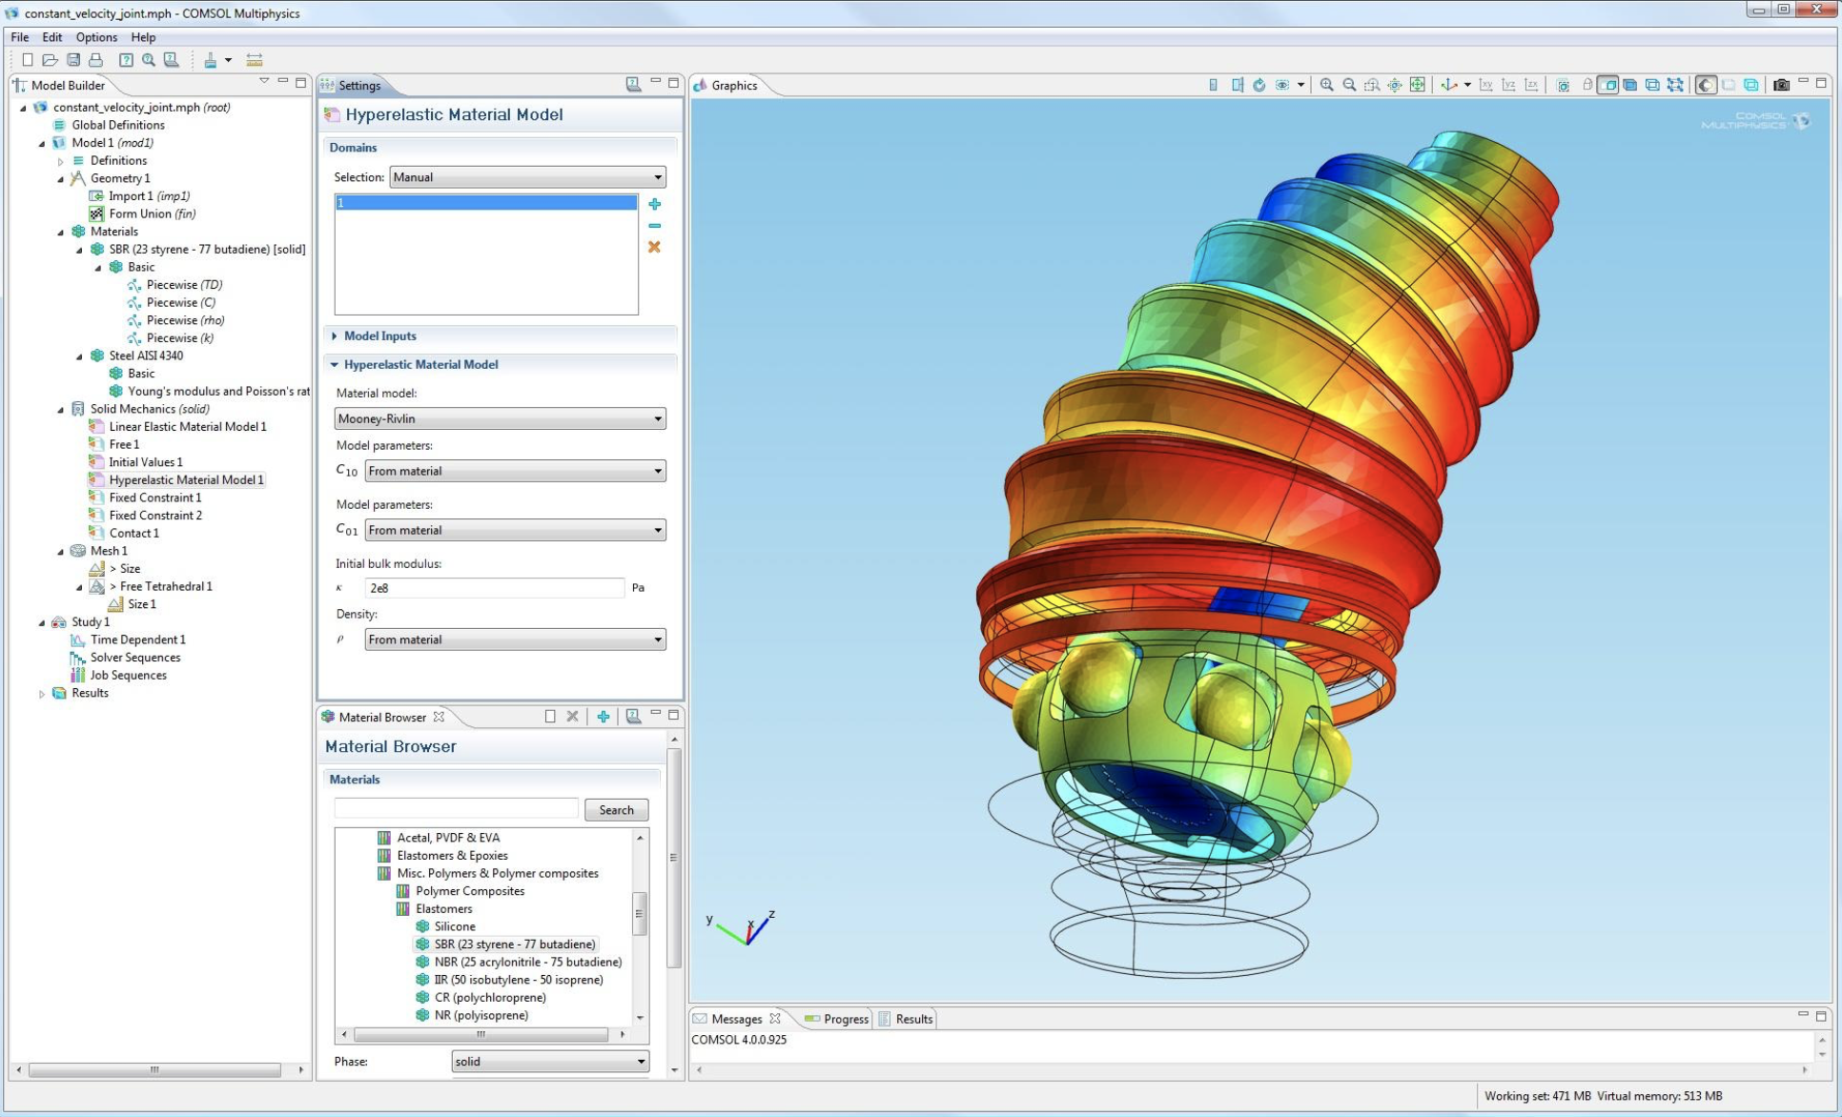
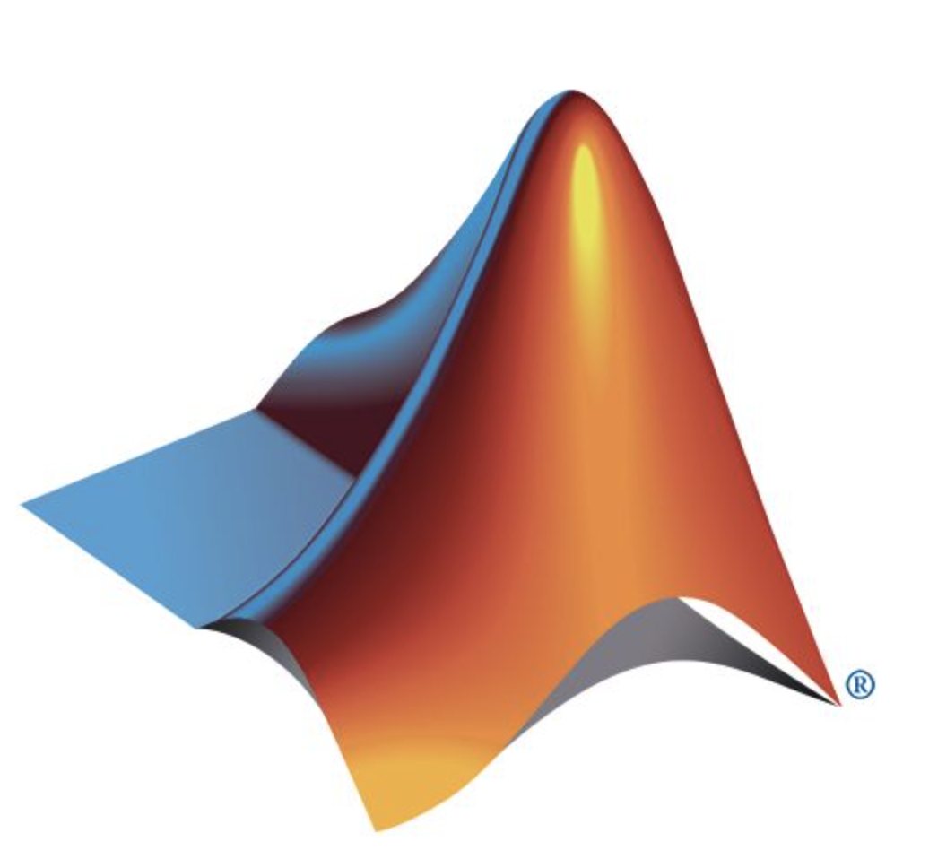
Method Tools
COMSOL
MATLAB
Notes:
COMSOL:
Finite Element Analysis 有限元分析方法
MATLAB:
Solid mechanics
公式
Electrostatic

Slide 5
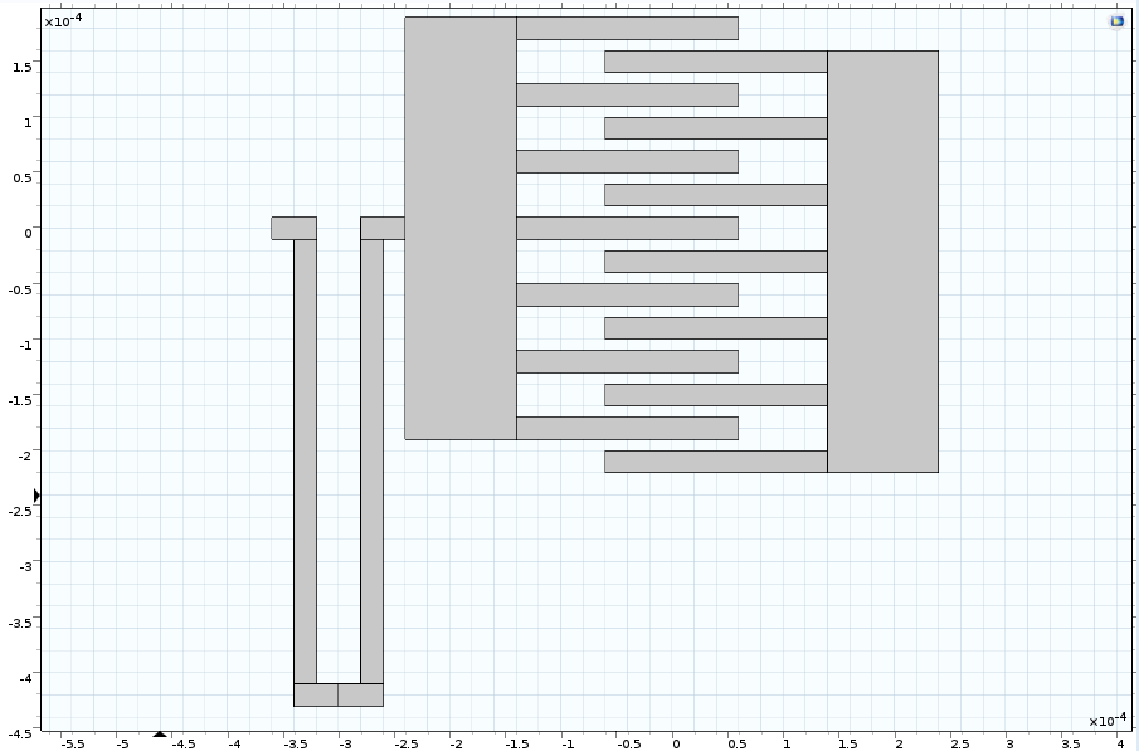
Schematic
50 um
Fingers: 200 um x 20 um
Initial
Gap: 40 um
Stators: 100 um x 380 um
Model
Spring：20um x 40 um
Gap: 40 um
MATERIAL:
Copper
Spring：
20um x 400um
Gap: 10 um
Notes:
3-D
双箭头+单箭头

Slide 6
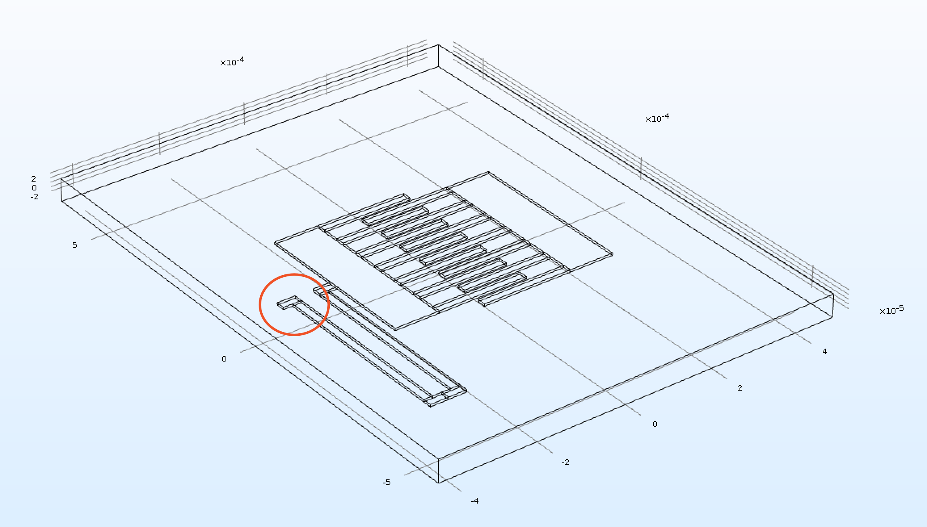
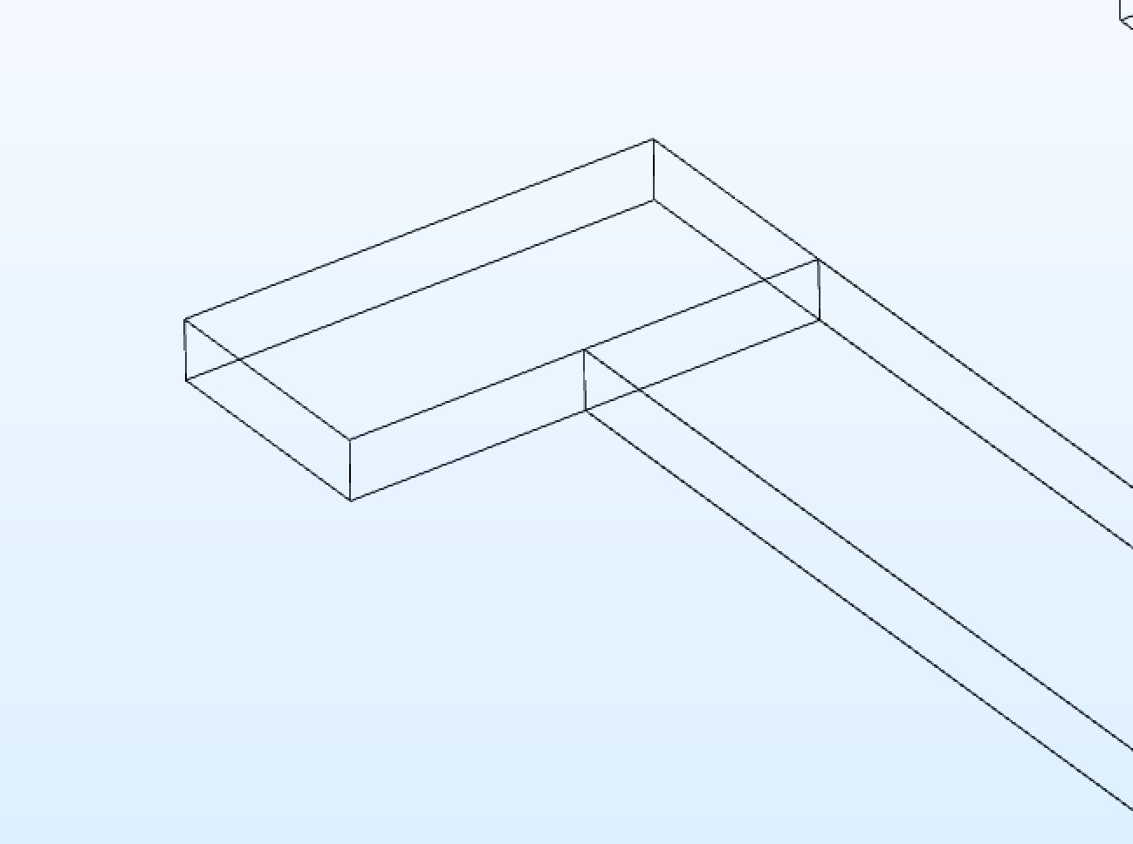
Schematic
Air:
900 um x 400 um x 50 um
Thickness:
5 um
Notes:
Background color----white
Zoom in
参数化
T_air
P6，+p5
Comb drive
3-d plot,+2-d top view

Slide 7
Direction
step4
Moving mesh
step5
Find the reaction
step6
Electrostatic response
Change the geometry
step1
Optimization
step2
Specific Eigen-frequency
step3
Notes:
平面 cancel

Slide 8
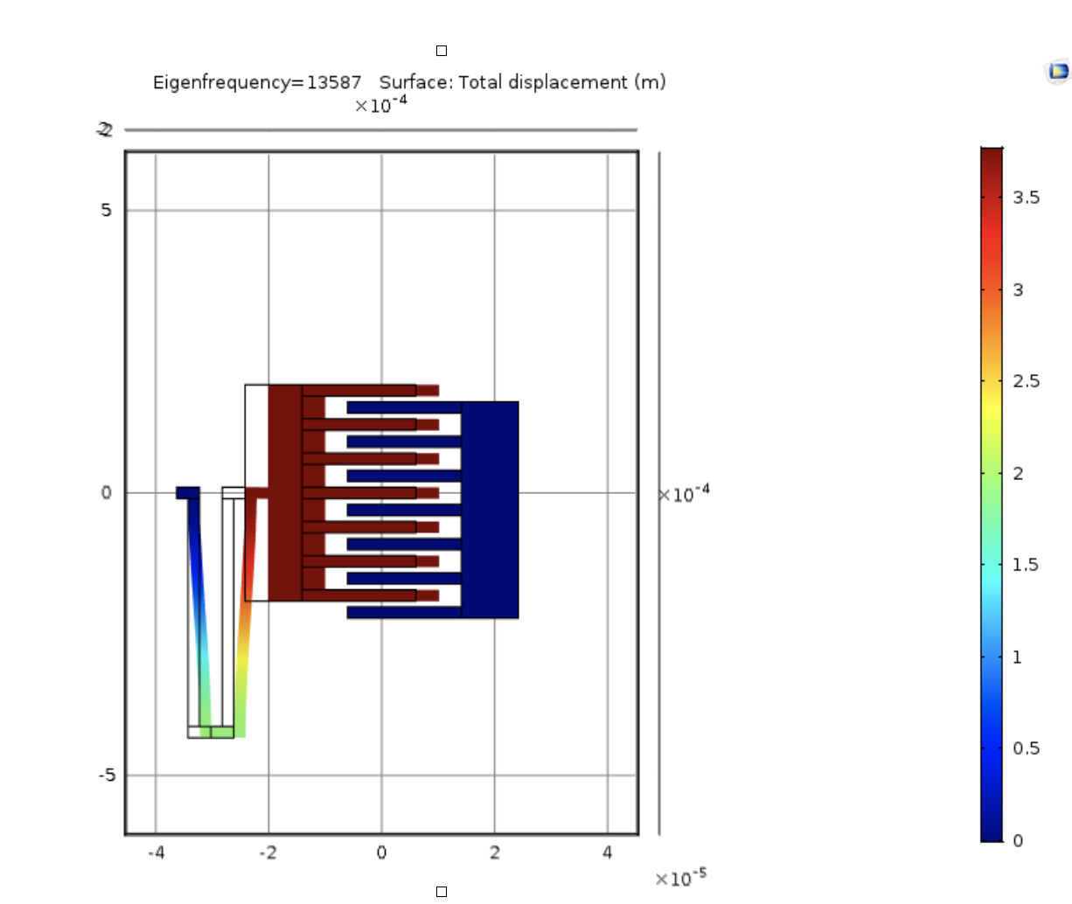
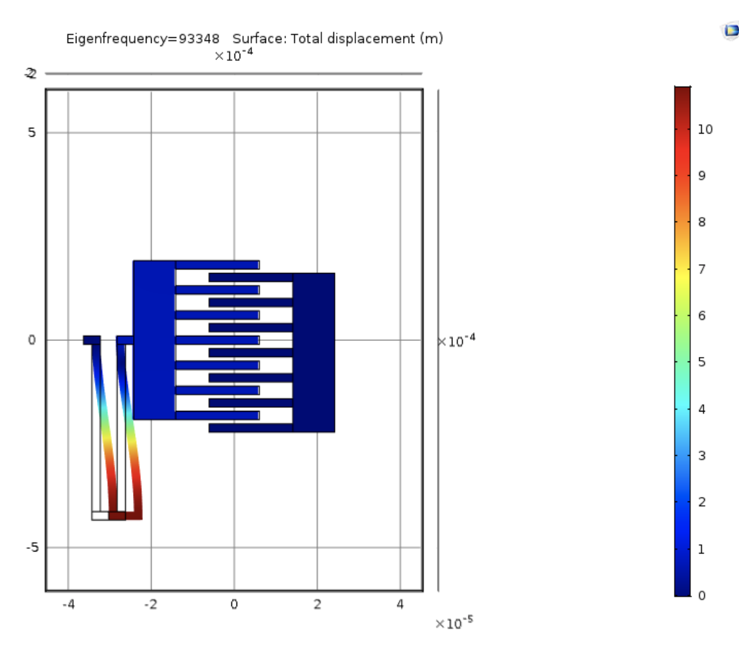
Process
Find the initial Eigen-modes
Notes:
c

Slide 9
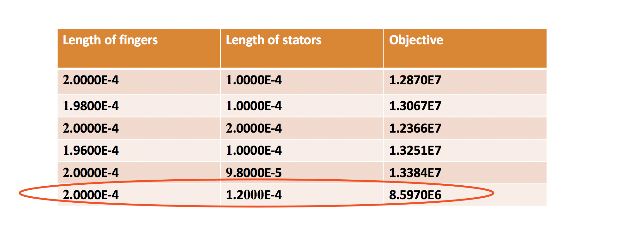
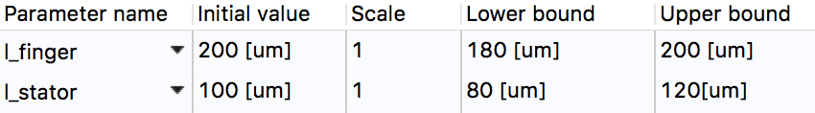
Process
Optimization result
Objective: Eigen-frequency close to 10000Hz
The number of the result need to be minimized
Bounds
tabel

Slide 10
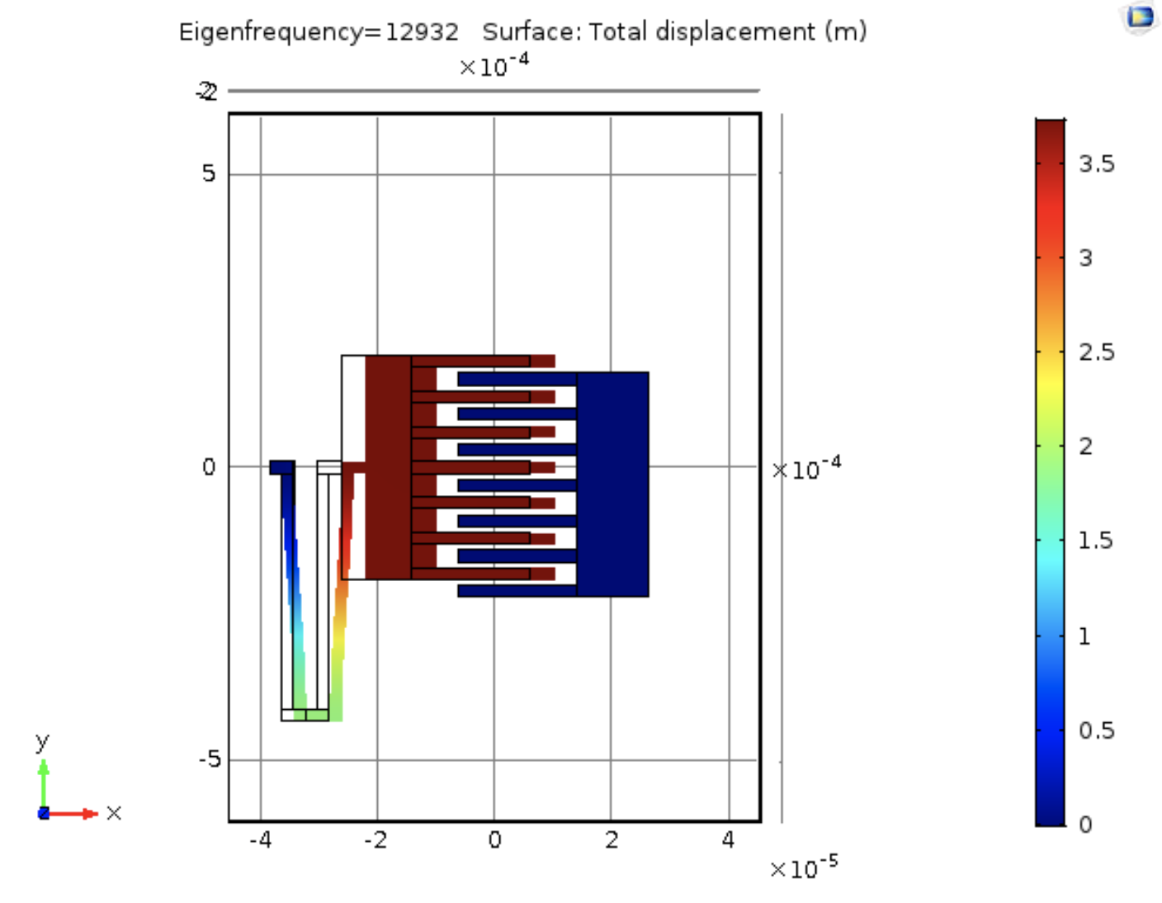
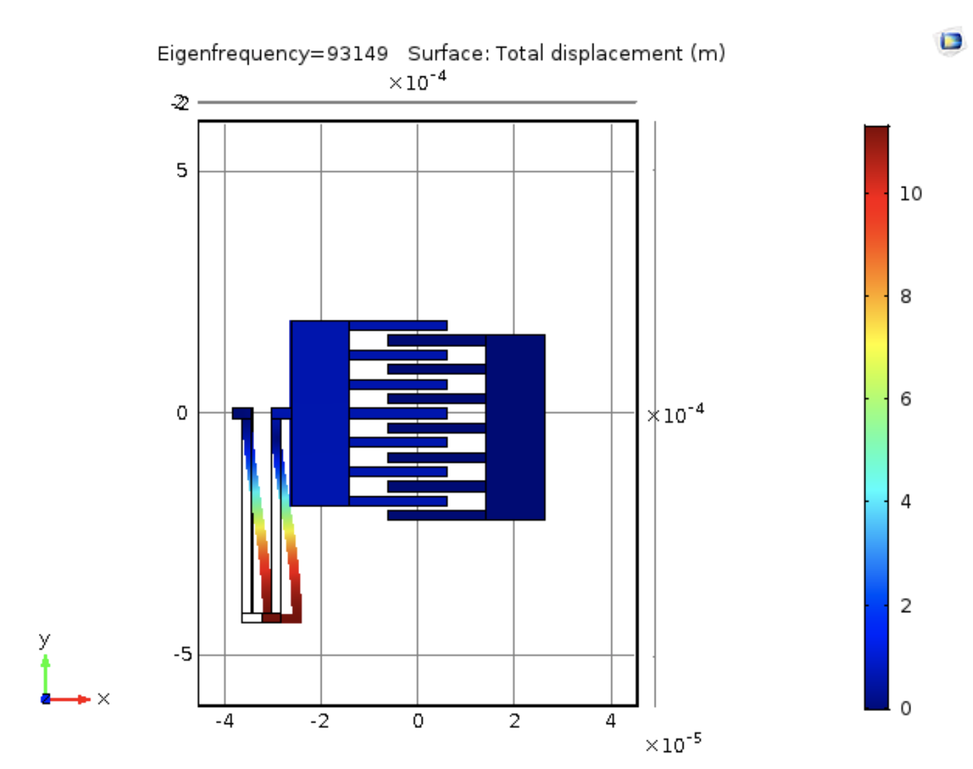
Process
Change the geometry
Length of fingers 200 um
Length of stators 120 um
Run the model again

Slide 11
Process frequency domain
Notes:
Run the frequency domain study (disable optimization module) from 2000 Hz to 5000 Hz. Add domain probe to output the displacement (u) of domain 8. Save the data (displacement v.s. frequency) and plot two curves in the same figure for comparison in Matlab.
Cancel the air box
Because of the symmetry,
Represent whole

Slide 12
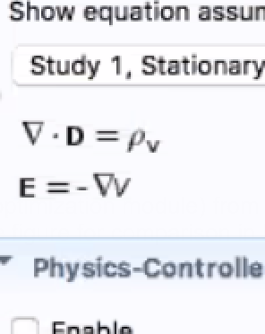
Process
Formula
Notes:
哪里fix 哪里动

Slide 13
END
THANKS!!
Notes:
Model：2d 3d
哪些方法 公式
什么方法？ Numerical
Eigen mode optimization
改
电容变化
Result
Frequency domain 变化
Capacity 的改变
我们的model很好
Optimize之后和最初pre-optimize的capacitor的变化
不同的geometry
2000-5000 rocket domain范围表现不错

